Slide 1
Traditional Parallel Computing vs Parallel Computing with Cloud
Andrew Xie, Antonio Mena, Prayag Patel

Slide 2
Background

Slide 3

Project Goal & Implementation
Goal: Compare traditional parallel computing vs parallel computing with cloud
Implementation Task: Gravity simulator that tracks particle trajectories
Why This Problem?
Classic scientific computing problem
O(n²) computational complexity
Naturally distributable workload
Technologies Used:
Traditional: Spark (pySpark)
Cloud: MPI on AWS EC2 nodes

Slide 4
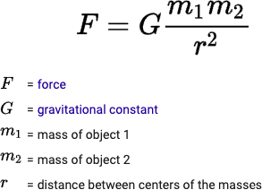
Gravity Simulation Background
Particles in the simulation have:
Position
Velocity
Mass
Newton’s Law of Universal Gravitation
Applications:
Predict cosmic collisions
Future particle positions and their impact on other nearby cosmic objects
Compare with real world data to verify known objects and identify unknown objects

Slide 5

What is Amazon EC2?
Amazon Elastic Compute Cloud (EC2) provides scalable, on-demand computing resources in the AWS Cloud.
EC2 enables you to launch virtual servers (instances) and scale resources based on workload requirements, reducing hardware costs and enabling faster application development and deployment.

Slide 6
How do EC2 Instances Work?
Instances: Virtual servers that run applications and processes in the cloud. You choose the instance type based on your project’s resource needs (CPU, memory, storage, and networking).
Instance Types: Each type offers different combinations of resources to support different workloads, ideal for tasks like parallel computing with MPI.
Amazon Machine Images (AMIs): Pre-configured templates for your instances, which include operating systems and additional software required for your project.
Instance Lifecycle: You can start, stop, or terminate instances as needed. When an instance is terminated, its resources (such as temporary storage) are released.

Slide 7
Related Work

Slide 8
Existing Comparisons Between Spark and MPI
Using the Cloud for parameter estimation problems: comparing Spark vs MPI with a case-study (Gonzalez, Pardo, et al.) [1]
Performance Evaluation of Apache Spark Vs MPI: A Practical Case Study on Twitter Sentiment Analysis (Kumar, Rahman) [2]
Big Data in metagenomics: Apache Spark vs MPI (Abuín, Lopes, et al.) [3]
Comparing Spark vs MPI/OpenMP On Word Count MapReduce (Junhao Li) [4]
Existing studies similarly evaluate Spark and MPI frameworks against different use cases.
This project bridges the gap between scientific and big data workloads:
gravity simulation employs both compute-heavy calculations and complex communication for particle interactions
This project emphasizes parallel cloud computing:
our MPI experiment is run directly on AWS EC2 cloud infrastructure, reflecting real-world cloud computing scenarios

Slide 9
Traditional Parallel Computing (Spark)

Slide 10

Traditional Parallel Computing (Spark)
Implementation details:
Leveraged pySpark with numpy and dataclasses
Particle class: stores 3D position, velocity, mass
Force calculations using broadcasted particle data
Algorithm steps:
1) Force recalculation
2) State updates
3) Trajectory recording
Key Challenges:
Potential bottleneck from data shuffle costs
Not natively optimized for iterative workloads
Steps in the simulation incur overhead from task scheduling and serialization (due to use of RDDs)

Slide 11
Parallel Cloud Computing (MPI on EC2 nodes)

Slide 12

Parallel Cloud Computing (MPI on EC2 Nodes)
Implementation approach:
Custom Particle data structure
Vector utility functions for 3D arithmetic
Even distribution of work across MPI “ranks”
Global synchronization using MPI_Allgatherv
AWS setup:
Used t2.micro instances (free tier)
1 master node + 2 slave nodes
Passwordless SSH for node communication
Horizontal scaling to overcome single-processor limitation
Leverage EC2’s placement group to colocate instances and reduce communication latency
MPI built-in that gathers data from all tasks and broadcasts the data to all tasks

Slide 13
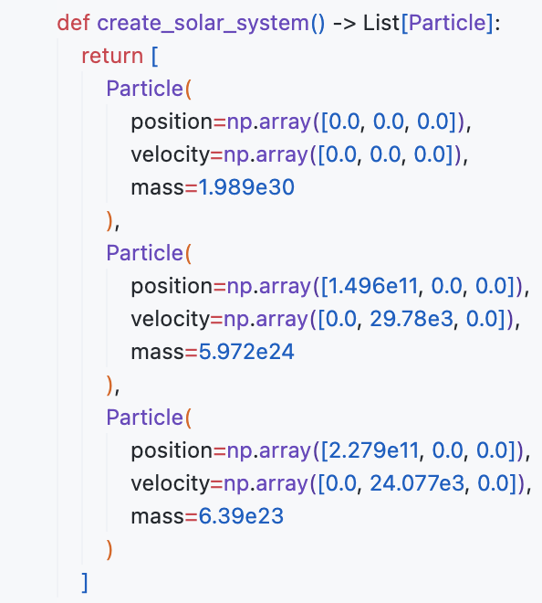
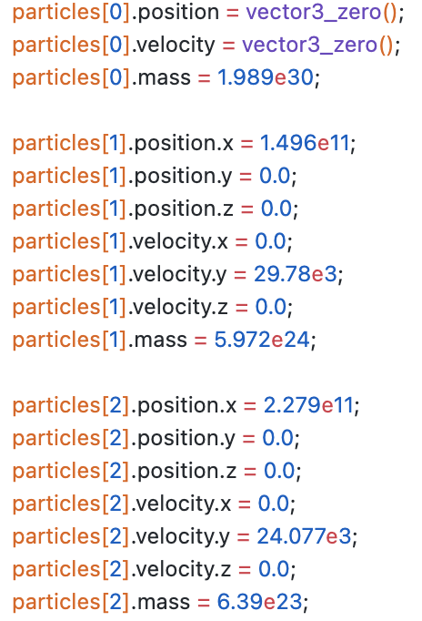
Initial Parameters
Python (pySpark)
C (MPI)

Slide 14
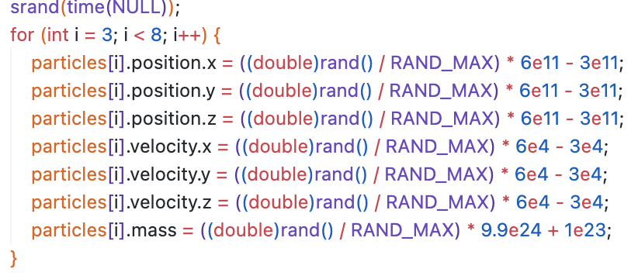
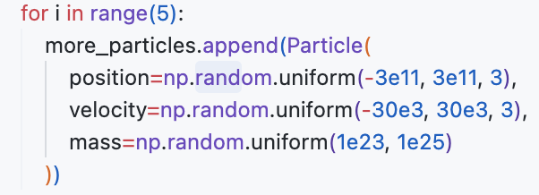
Random Particles
Python (pySpark)
C (MPI)

Slide 15
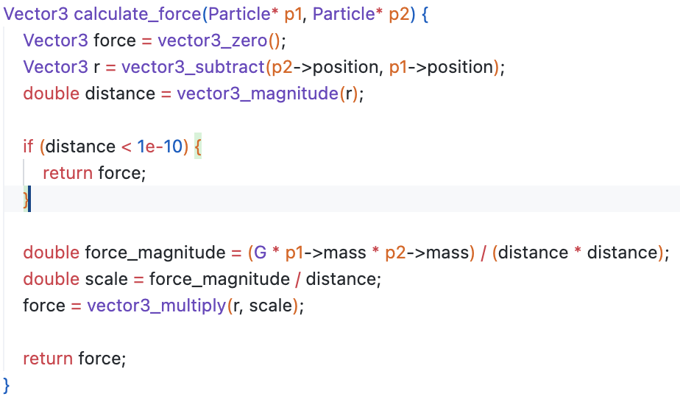
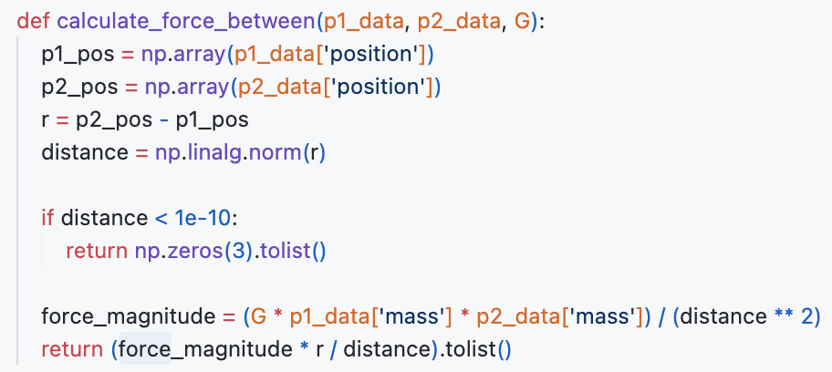
Force Calculation
Python (pySpark)
C (MPI)

Slide 16
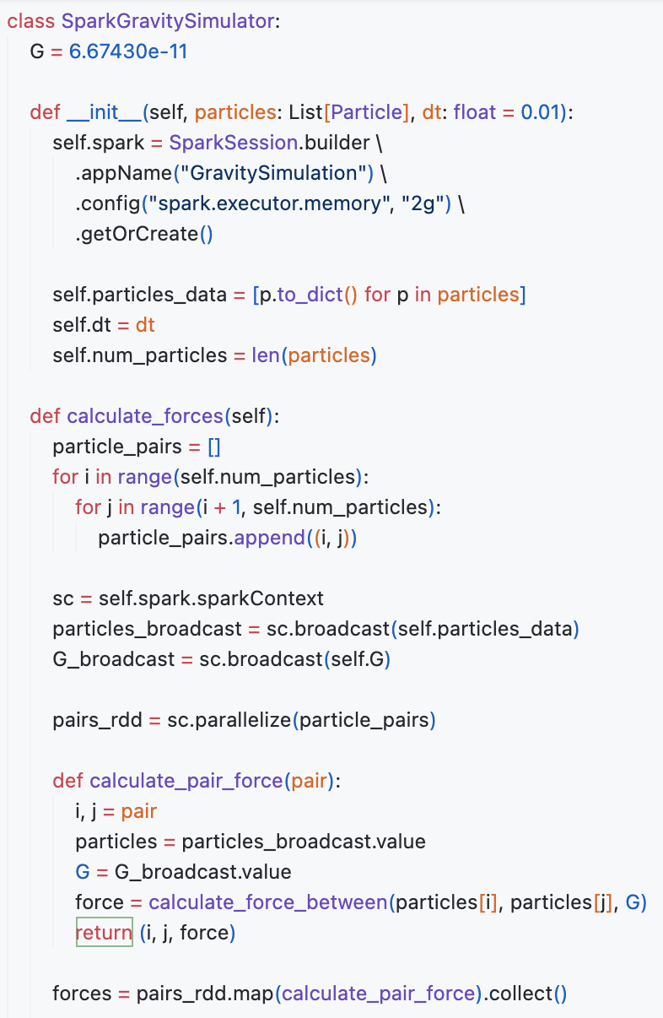
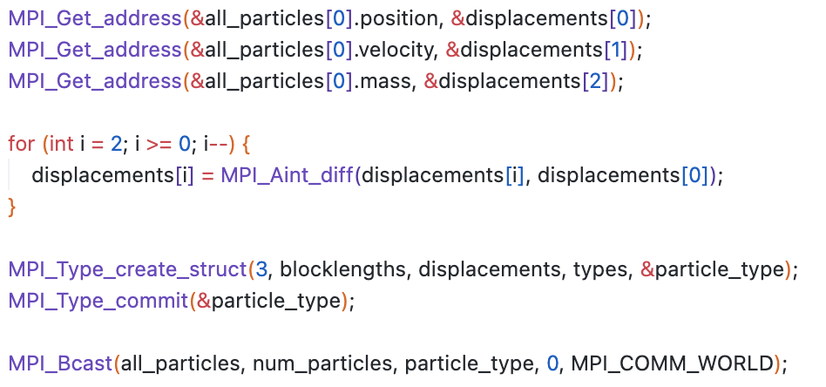
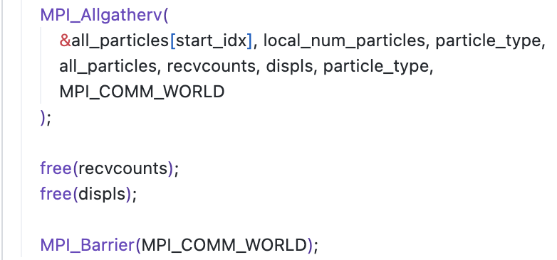
Parallelization
Python (pySpark)
C (MPI)

Slide 17
Output
Python (pySpark)
C (MPI)
Starting gravity simulation at 20241211_020916
Configuration:
- Number of steps: 500
- Time step: 3600 seconds (1 hour)
Performance Statistics:
Total execution time: 55.43 seconds
Average time per step: 0.1109 seconds
Final positions:
Particle 0: (-40759.92361748901, 83021.92422931321, -15339.827766454993)
Particle 1: (140072929991.45477, 52463379787.609665, -21994.541876042145)
Particle 2: (223763210109.76465, 43076578937.28692, -20591.140443501015)
Particle 3: (-220536191887.73007, -131004855333.84792, -270275726748.04044)
Particle 4: (69353928904.48807, 203022216340.21124, -168798879233.916)
Particle 5: (-203270117941.5046, -190823886331.11755, -272352403694.52585)
Particle 6: (216587611342.19537, -42911503641.20782, -259177568462.8093)
Particle 7: (-26352676432.34539, 13632601778.28655, 23526204261.72007)
Simulation completed successfully
Starting MPI C gravity simulation at 20241211_015031
Number of processes: 3
Number of particles: 8
Steps: 500
Timestep: 3600.000000 seconds
Performance Statistics:
Total execution time: 0.28 seconds
Average time per step: 0.0006 seconds
Final positions:
Particle 0: (2.038543e+04, 7.519318e+03, 4.330912e+03)
Particle 1: (1.400729e+11, 5.246338e+10, 4.085081e+03)
Particle 2: (2.237632e+11, 4.307658e+10, 3.633190e+03)
Particle 3: (3.104993e+11, 7.523407e+10, 2.527527e+11)
Particle 4: (-7.151560e+09, 1.482256e+11, 1.320689e+11)
Particle 5: (-1.181584e+11, 1.983205e+11, 2.194526e+11)
Particle 6: (-2.203978e+11, -6.206211e+10, -1.531738e+11)
Particle 7: (-1.774408e+11, -1.023138e+11, 3.362449e+10)
Simulation completed successfully

Slide 18
Results & Conclusion

Slide 19

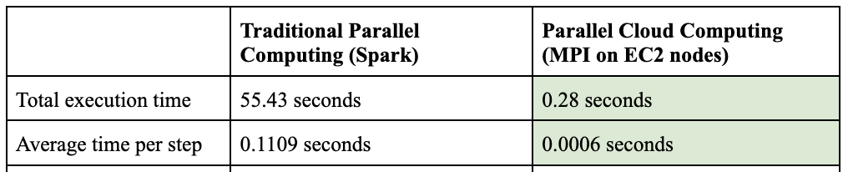

Results
~196.43 times speedup

Slide 20


PySpark vs MPI: Differences
MPI obviously performs better than PySpark because the gravity simulator used on AWS is written in C (statically typed compiled language vs dynamic interpreted Python)
MPI is low-level and requires better coding practices, it does not handle fault tolerance and must be written in C
PySpark is high-level, relatively easier to implement and has a higher level of abstraction

Slide 21
Limitations of Spark & Traditional Parallel Computing
As particle count is increased, the Spark implementation tends to struggle more with growing communication overhead, while MPI maintains relatively constant performance.
Spark is optimized for data-parallel workloads with minimal inter-task communication.
Frequent communication between particles (tasks) in this problem is critical.
At each simulation step, Spark needs to refresh data using RDDS, which implicitly incurs serialization, deserialization, and disk/memory storage overhead.

Slide 22
PySpark vs MPI: Increasing Efficiency?
However, some improvements can be made to the PySpark code by optimizing memory used by the RDD, vectorizing operations, etc.
Better use of broadcast variables and smarter partitioning could improve performance
The C code could also be improved by optimizing MPI, using more sophisticated algorithms, data management, etc.
Implementation of non-blocking communication could improve performance

Slide 23
Conclusion
Key insights:
MPI & EC2 implementation significantly outperformed Spark for the gravity simulation problem
Spark has clear limitations for tightly-coupled, iterative problems
Cloud computing (via Amazon EC2) enabled efficient scaling
Future considerations:
Optimization opportunities for both platforms
Potential for hybrid approaches
Further benchmarking and testing needed
Exploration and comparison of approaches for different use cases and problems

